Slide 1

PROJECT

Slide 2

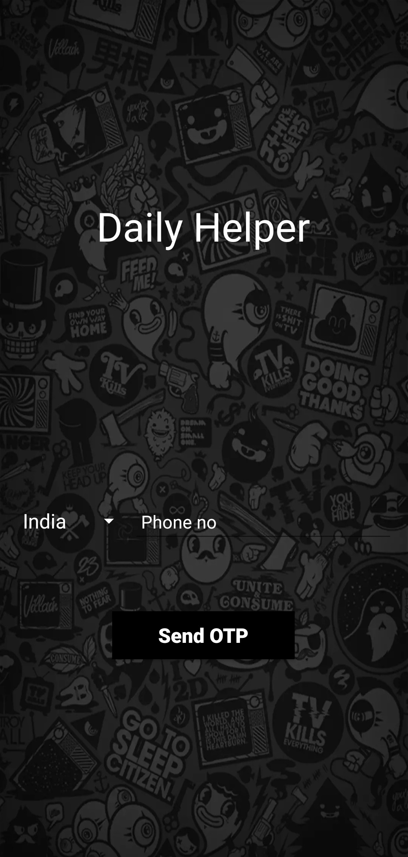
Daily Helper
Daily Helper is an Android Application which helps users select a service from a wide range of services.
Services like car mechanic, plumber, gas repair, electrician are available.
The app begins with a login page which asks for an OTP so that the user gets logged into the app.
The app sends a 5 digit OTP to the user which is automatically detected and the user gets logged into the app.
This feature of logging is performed with the help of Firebase Authentication.

Slide 3
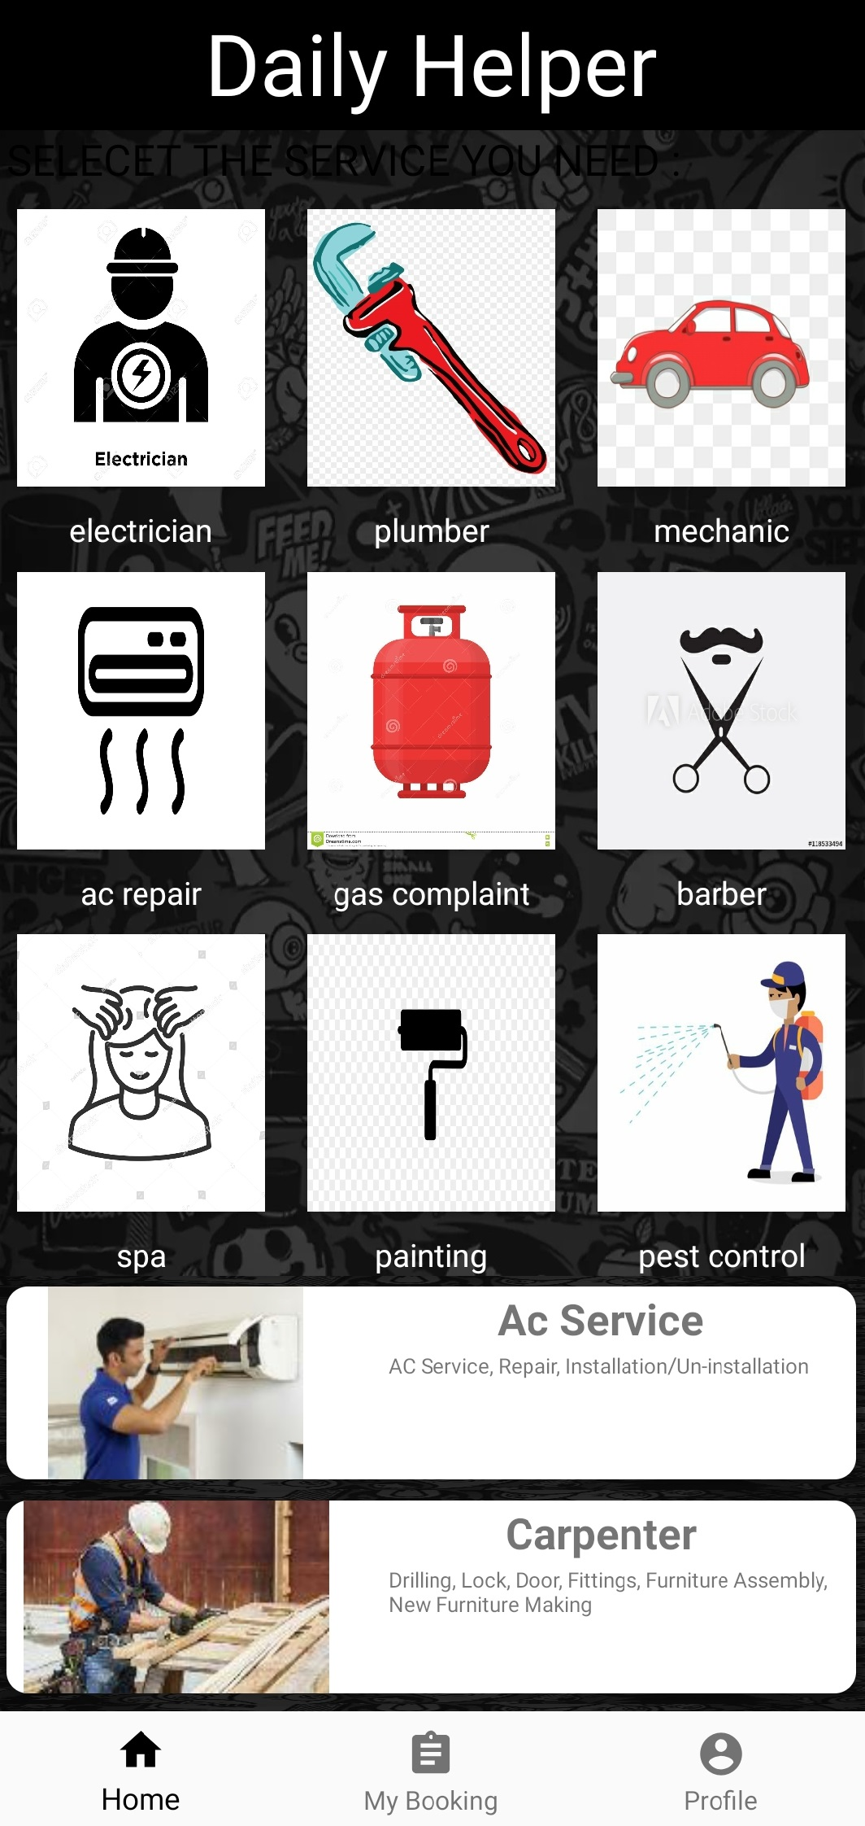
After logging into the app, the user gets to choose the service he wants.
The transition from one activity to another activity takes place with help of intent.
As shown in the screenshot, various services are that of an electrician, plumber, car mechanic, barber etc.
This section is divided into two layouts. The first layout consists of buttons which are arranged in 3x3 format.
The second layout consists of a Recycler view.
In a Recycler View, we can continuously keep on scrolling.

Slide 4

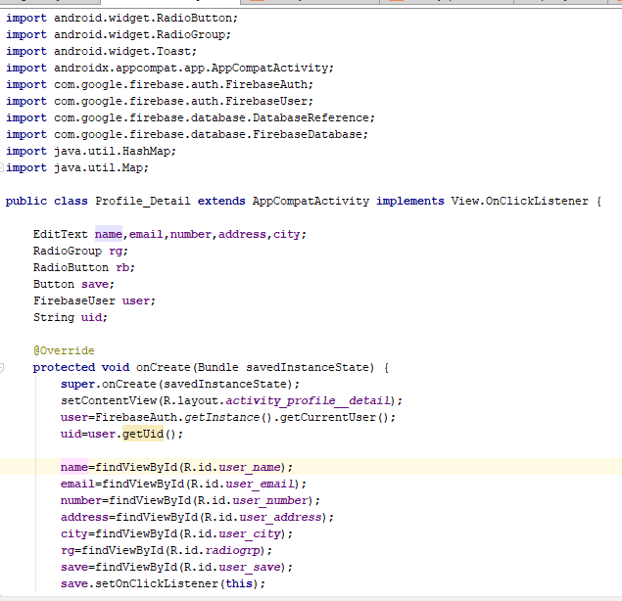
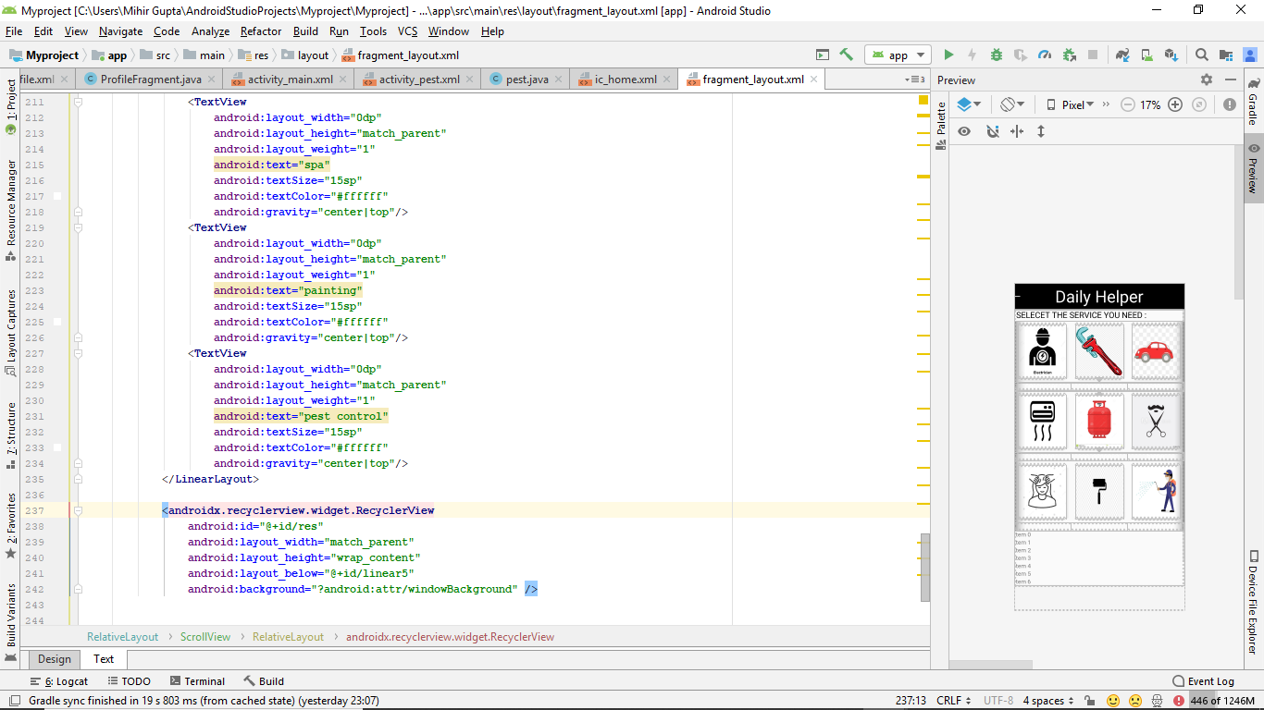

Fig: XML file for previous layout
Fig: Java file for previous layout

Slide 5
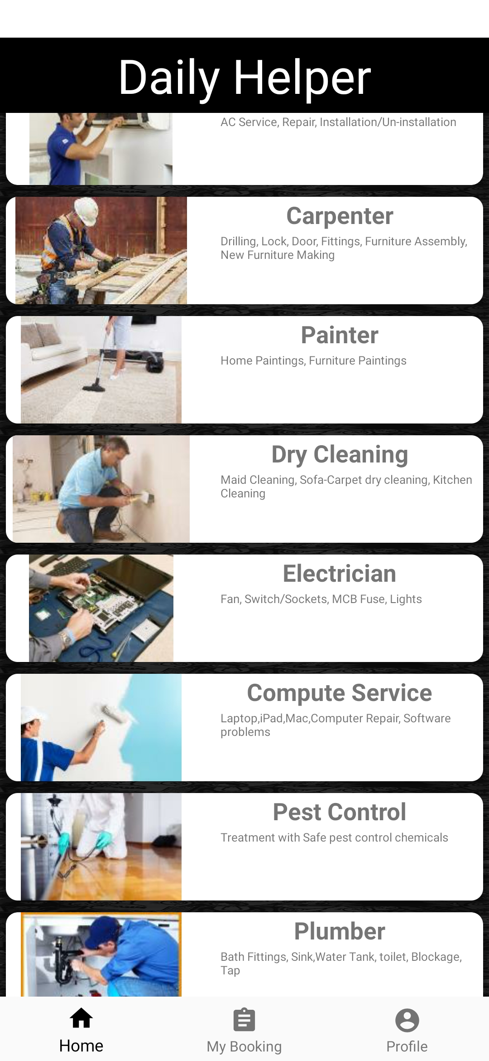
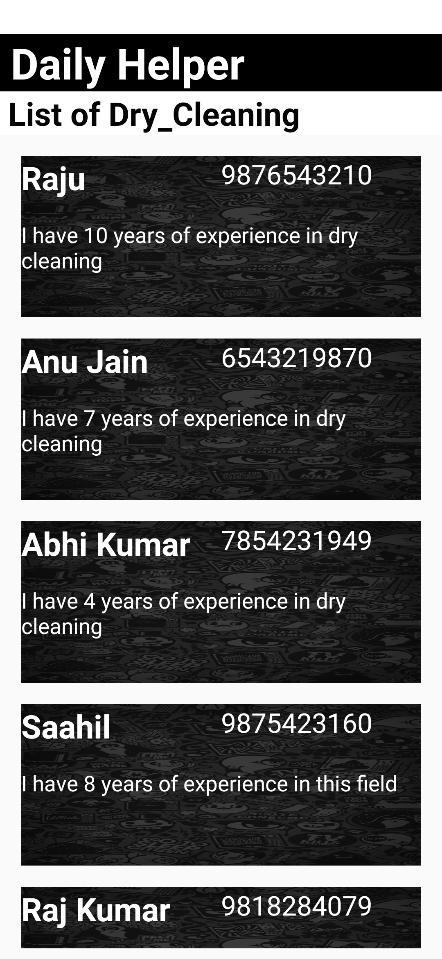
Once the user selects a service, new activity opens which shows details of all the service providers related to that field.
eg: here it shows list of all the dry cleaners with their phone number and details.

Slide 6
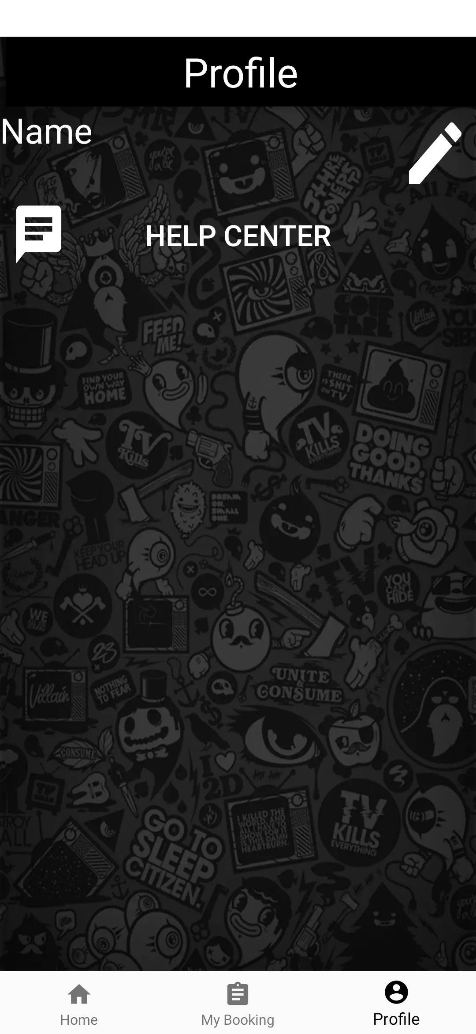
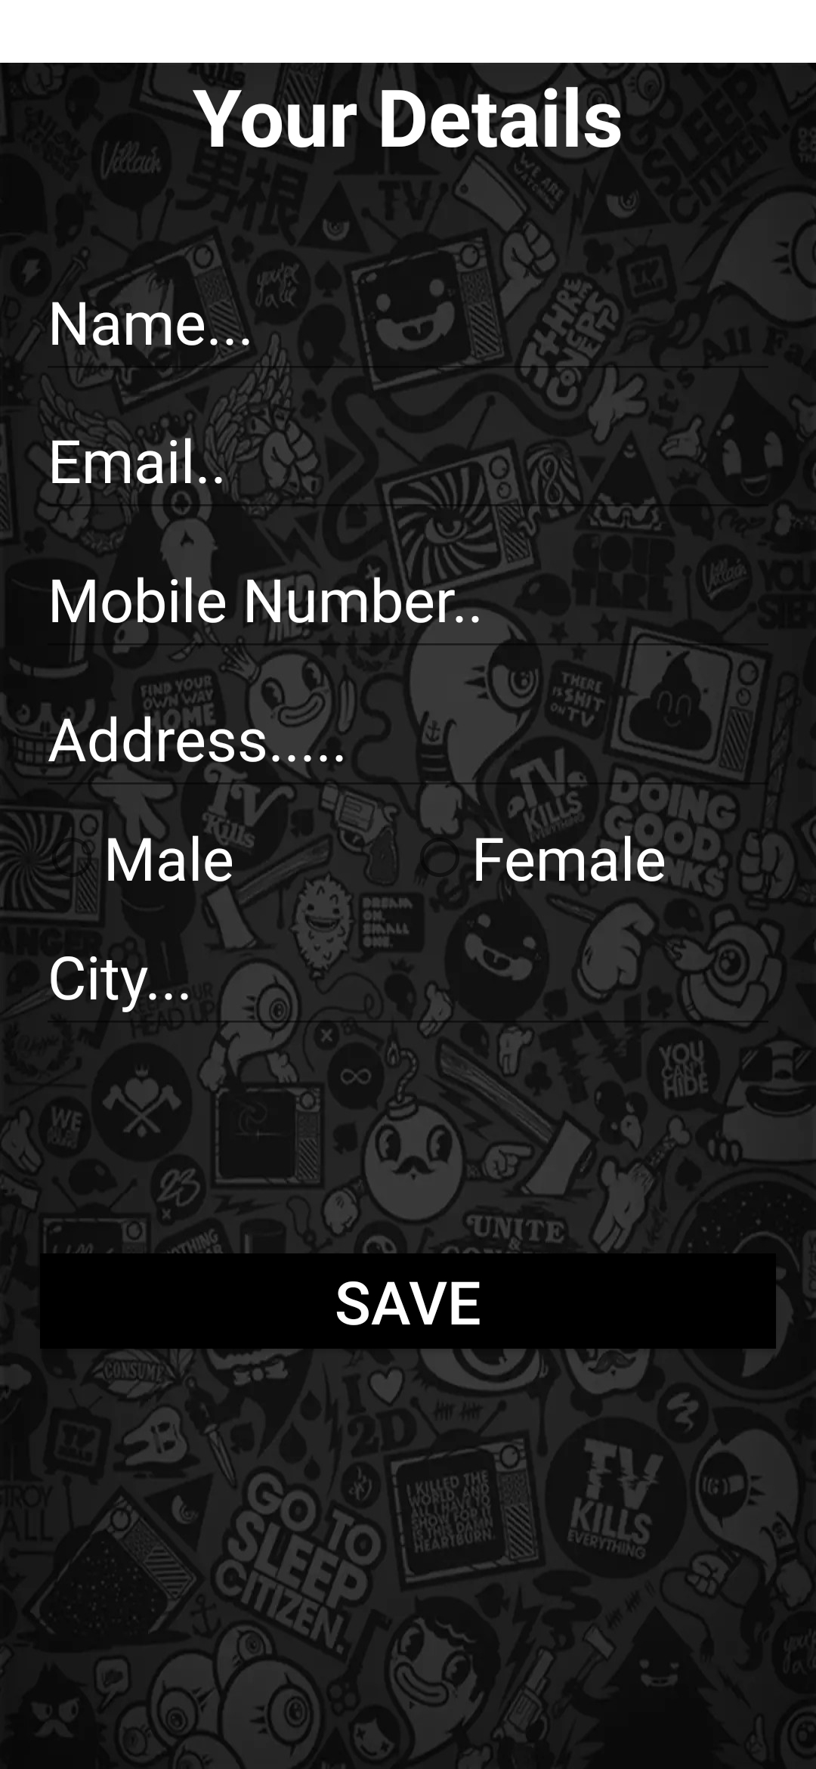


The arrows indicate what happens when 'Profile', 'Help Center' and edit buttons are pressed.

Slide 7
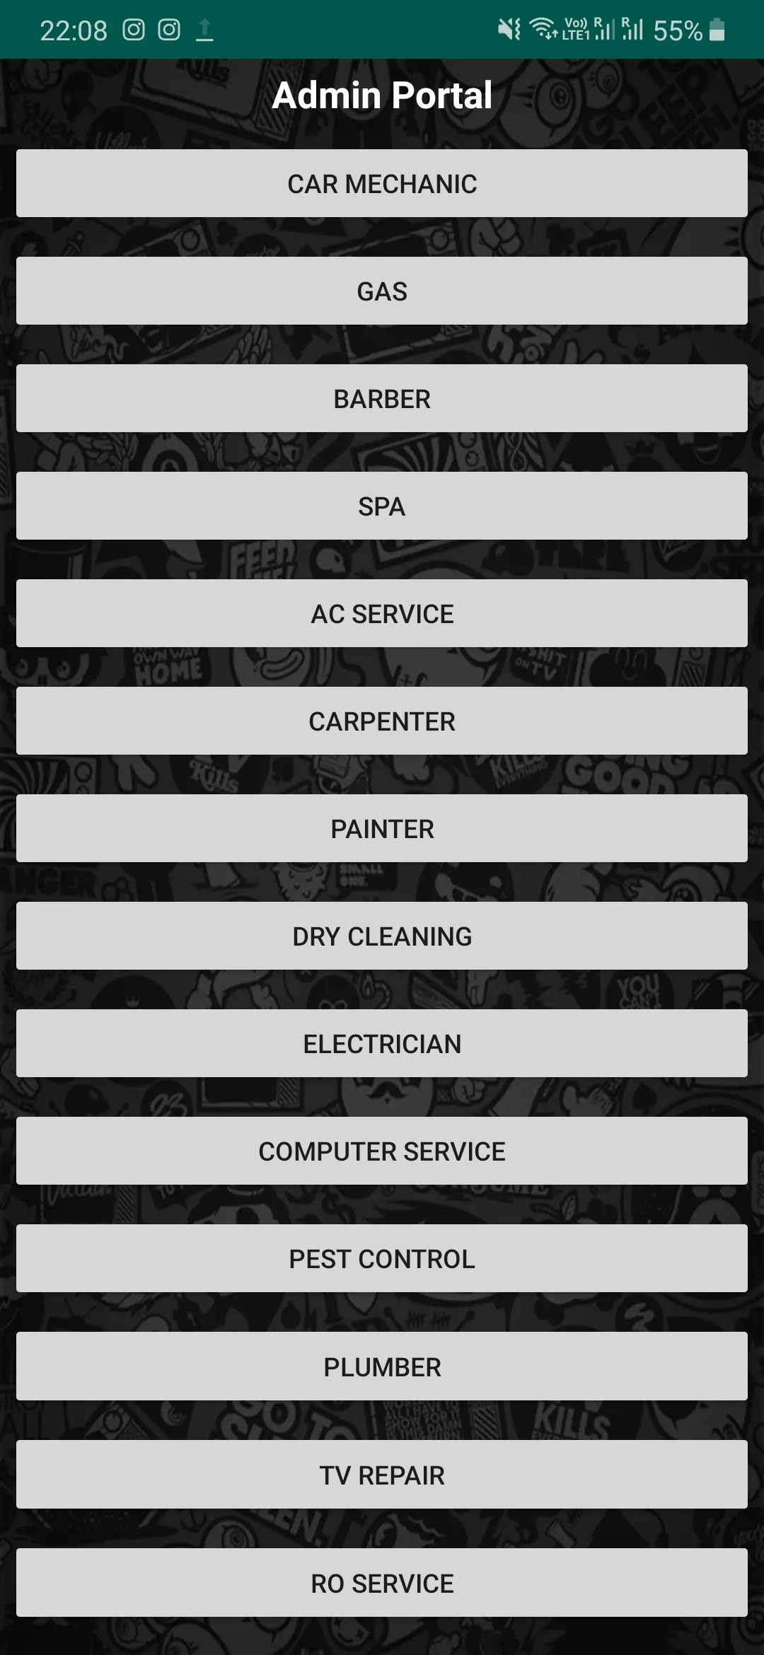
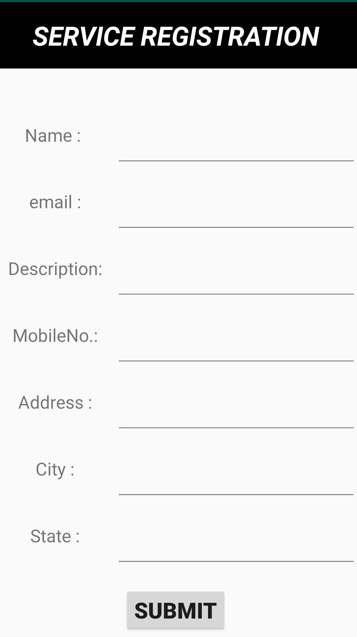
Admin Portal
The admin portal is the place where the service providers can register themselves.
They have to select the serrvice and then provide their basic details, once they press 'submit' their details are saved in the database.
The details are then retrieved from the database and are made available in the user portal.
The details are saved on an online database i.e. Firebase. Firebase is a product by Google.

Slide 8
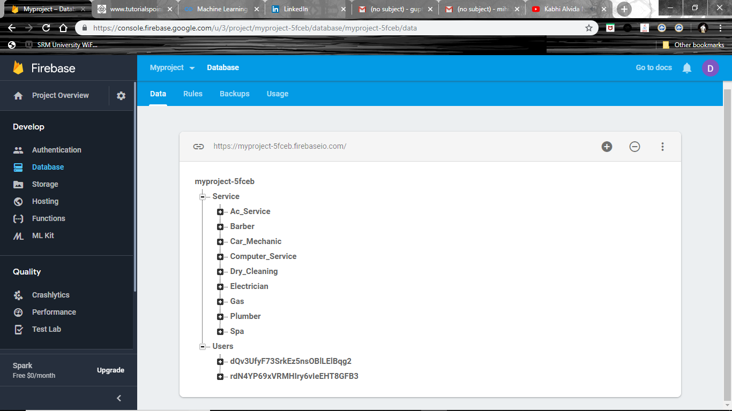
Database
The screenshot shows that the databse has two fields: service and users.
Service is to store data of the service provider and user is used to store user information.
Service section is furthur divided into many categories based on the various services available.
For using this feature of Firebase we just have to import the firebase libraries into our java file.

Slide 9
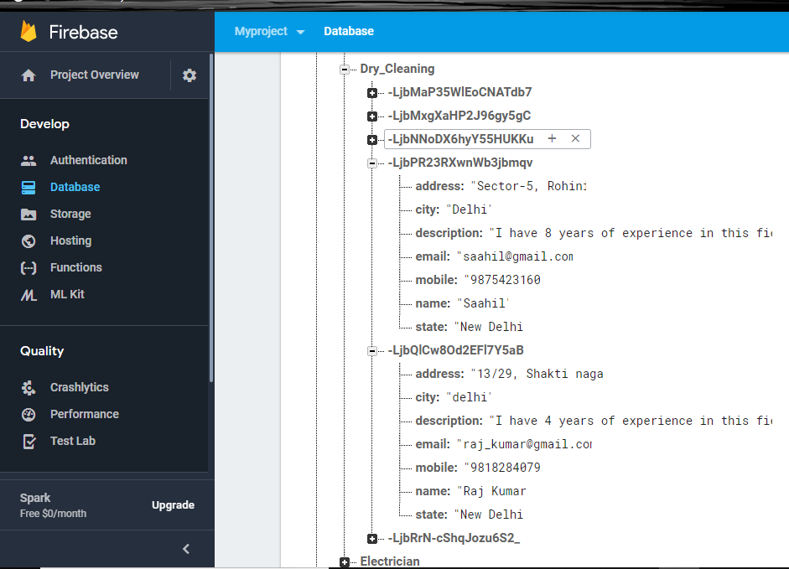
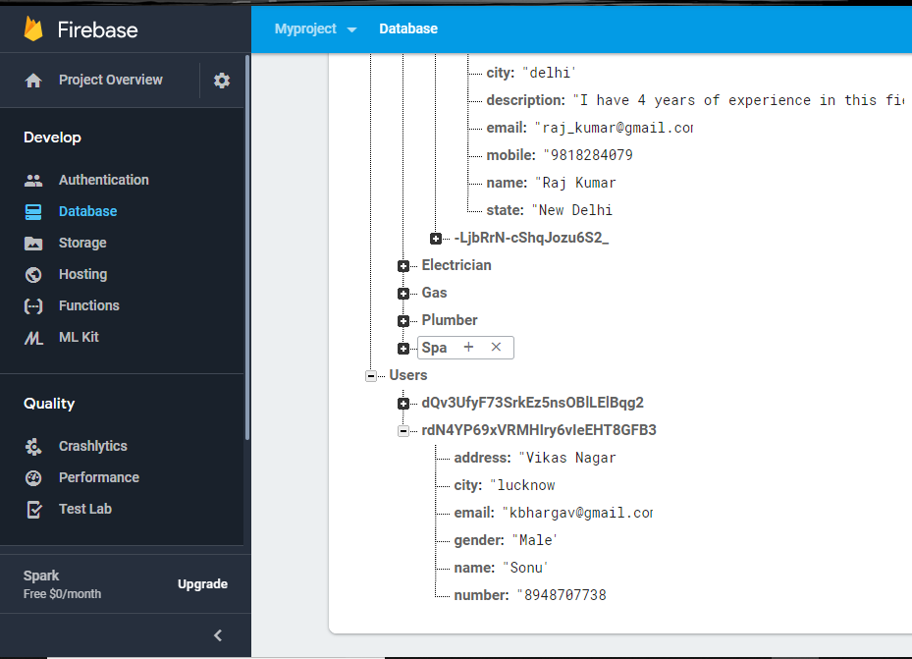

Fig: database of service providers
Fig: database of users

Slide 10
Conclusion
The training was based on learning and getting knowledge on how an android application works.
The objective of the project was to study, understand and implement what I understood about android.
Developing an android application is very difficult task and it takes lot of time to develop an app.
The android market is increasing at a very rapid pace and this development would keep on going generating more job oppurtunities in this field.

